Slide 1
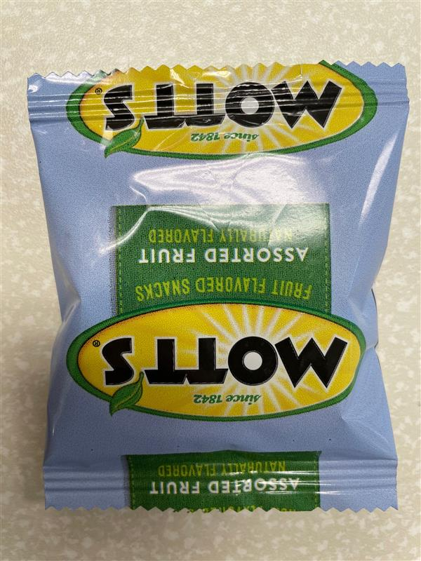
Project Sesame
Mott’s Fruit Snacks Packaging IHUT
April 2023

Slide 2

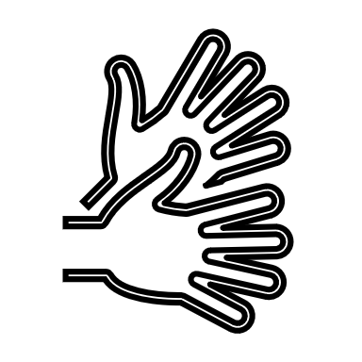

Background
Remarkable Experience Framework (F22) Recommendation
Consider adding a pre-cut slit on the pouch to gain a packaging edge.
Neither product achieves true superiority in terms of packaging preference, as triers of both cite similar strengths, like ease of opening or design appeal.
While Mott’s has a more prominent tab on the box, which makes for easier opening, Welch’s features a perforated slit on the pouch, which parents note is better for their children.
Packaging R&D’s Solution
Add a tear notch to the seam of the packaging.

Slide 3
Test Objectives
Mott’s Test vs. Welch’s
Using Welch’s tear notch as an in-market benchmark, determine if Mott’s tear notch performs at parity to Welch’s tear notch.
1
Mott’s Control vs. Mott’s Test
Validate a claim that the added tear notch creates an overall easier to open pouch of fruit snacks for both parents and children.
Claim: “Now easy to open”
2

Slide 4

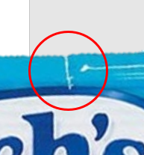
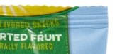
Recruiting Criteria & Sample Info
Group 1:
Mott’s Test vs. Welch’s
Group 2:
Mott’s Test vs. Mott’s Control
Recruit:
Mott’s and Welch’s consumers 2x in P3M (quota minimum 50% per product, cross over encouraged).
Parents with kids ages 2-8
Samples
Mott’s Test (with tear notch)
Welch’s
Recruit:
Mott’s consumers 2x in P3M
Parents with kids ages 2-8
Samples
Mott’s Test (with tear notch)
Mott’s Control (no tear notch)

Slide 5





Test Flow
Group 1: Mott’s Test vs. Welch’s
Group 2: Mott’s Test vs. Mott’s Control
Pre-Usage Survey:
Ease of Opening Expectation
Typical opening method
Pre-Usage Survey:
Ease of Opening Expectation
How do you normally open the pouch?
Voice Survey
Pinch Pull Open Usage Survey:
Overall package liking (9 pt.)
Rating Effort Scale (Adult-Unprompted)
System Usability Scale (Adult)
Post-Use Survey
Rating Effort Scale
Overall package liking (9 pt.)
System Usability Scale (Adult)
Tear Notch Usage Survey
Rating Effort Scale
System Usability Scale (Adult)
Child Usage
Rating Effort Scale
System Usability Scale (Child)
Child Usage
Rating Effort Scale
System Usability Scale (Child)
Final Comparison: Which pouch was easiest to open? (A, B, neither, both)
Final Comparison: Which pouch was easiest to open? (A, B, neither, both)

Slide 6
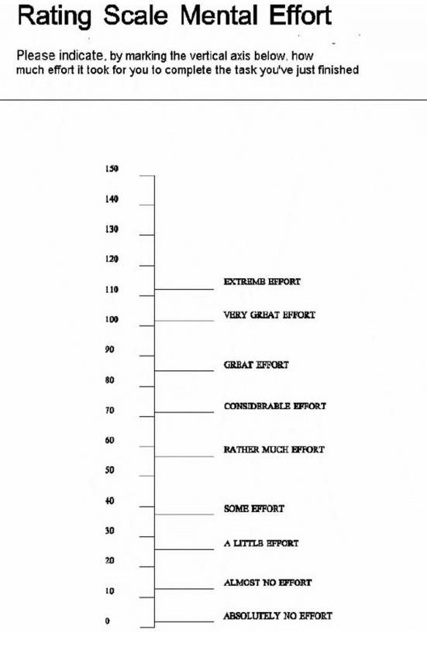
Method: Rating Scale Mental Effort
Standardized scale for effort needed to complete a task.
A low score = less effort to use.
Extreme Effort
Very Great Effort
Great Effort
Considerable Effort
Rather Much Effort
Some Effort
A Little Effort
Almost No Effort
Absolutely No Effort

Slide 7
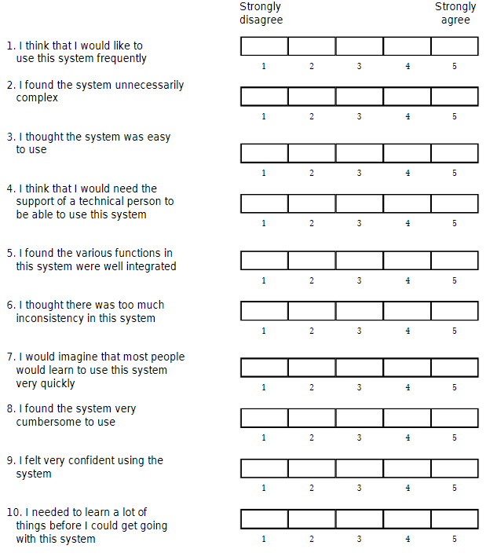
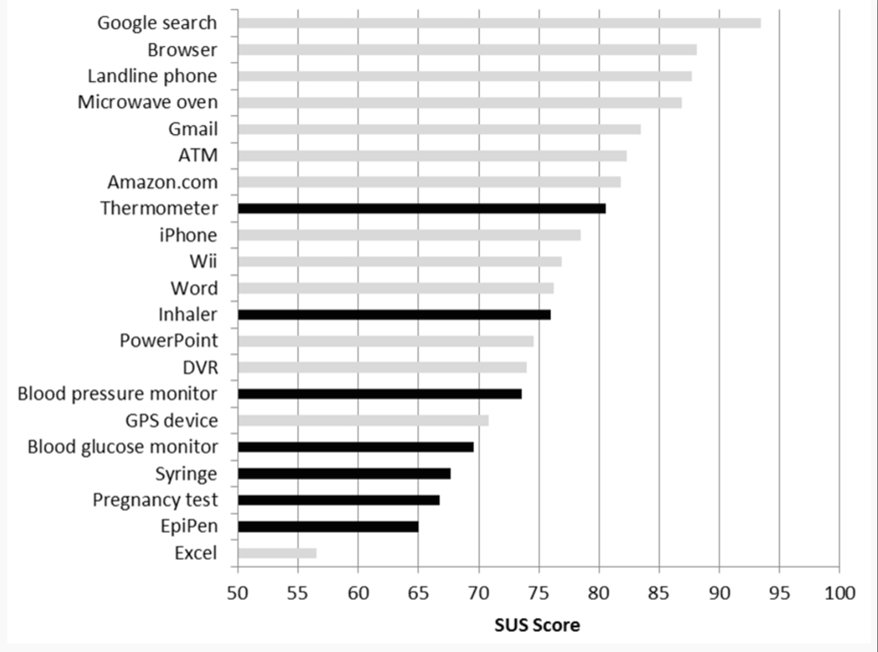
Method: System Usability Scale (SUS)
Standardized metric that is the industry standard in measuring the usability of websites and products (Bentley University).
Good experiences are 68 or above on this scale.
What Every Client Should Know about SUS Scores | Bentley University
Example Standardized Questionnaire
SUS Score Benchmarks

Slide 8
SUS Questions from Sesame Ballot
SUS Questions for Adults
SUS Questions for Adults to Answer About their Child
I think that I would use the tearing from the edge method to open this pouch frequently.
2. I found the packaging of this pouch unnecessarily difficult to open.
3. I thought the packaging of this pouch was easy to open.
4. I think I would need to try multiple times to open this pouch.
5. I found the tearing open of this pouch to be easy to complete.
6. I thought there was too much effort used to open this pouch.
7. I imagine that most people would be able to open this pouch easily.
8. I found the pouch awkward to use.
9. I felt confident opening the pouch.
10. I need to use another way to open this pouch other than tearing the edge.
I think that my child would use the tearing method to open this pouch frequently.
2. My child found the packaging of this pouch unnecessarily difficult to open.
3. My child thought the packaging of this pouch was easy to open.
4. I think my child would need to try multiple times to open this pouch.
5. My child found the tearing open of this pouch to be easy to complete.
6. It took my child too much effort to open this pouch easily on their own.
7. I imagine that most children would be able to open this pouch easily on their own.
8. My child found the pouch awkward to use on their own.
9. My child felt confident opening the pouch on their own.
10. My child needed to use another way to open this pouch other than tearing.

Slide 9
2/3rds of consumers typically tear the fruit snack pouch from the edge to open the pouch.
Having an easy-to-use tear open option for our fruit snack pouches will likely improve the packaging experience for around 2/3rds of the consumers.

Slide 10

Summary of Key Learning
Mott’s Test vs. Welch’s
Mott’s Test vs. Control
Mott’s is at parity to Welch’s in tear notch usability.
Opportunities for Mott’s improvement:
Place tear notch in top right corner.
Make tear notch more visible.
Direct consumer attention to tear notch.
Mott’s Test tear notch creates a significantly easier opening experience.
Move forward with a claim of easier to open.
Gogurt Example:
“Now easier to open” – 6 month claim
“Easy open” – evergreen claim
Consider using “tear notch”, or similar language, to tell consumers the tear notch is what makes it easier to open.

Slide 11
Group 1- Mott’s Test vs. Welch’s
Is Mott’s tear notch on par with Welch’s tear notch?

Slide 12



Mott’s tear notch is successful and is at parity with Welch’s. Some opportunities identified for further optimization.
Mott’s tear notch works at parity with Welch’s tear notch for opening the fruit snack pouch.
METRIC |  | MOTT’S TEST | WELCH’S
Rating Effort Scale 150 pt. standard scale (lower = less effort)
Adults |  | 25 | 23
Kids |  | 32 | 30
System Usability Scale (SUS) 100 pt. standard scale (higher = more usable)
Adults |  | 80 | 86
Kids |  | 64 | 66
Preference (Mott’s, Welch’s, or Neither)
Adults |  | 32% | 49%
Overall Package Liking 9pt. Hedonic
Adults |  | 7.2 | 7.5
Child Opening % kids could open on their own
Kid |  | 76% | 78%
Opportunities identified to further optimize pouches.
Superiority –Mott’s pouch is sig. higher than Welch’s pouch
Parity – Mott’s pouch is at parity with Welch’s pouch
Inferiority – Mott’s pouch is sig. lower than Welch’s pouch
SUS scores are adult focused for benchmarking. Kid SUS scores should only be looked at directionally and compared between samples, not benchmark values.
*indicates a significant difference at 95% CI.

Slide 13
Group 1 Diagnostics

Slide 14
While Mott’s and Welch’s were at parity, Welch’s was preferred.
16%
Neither, Both Easy
Welch’s had a few minor advantages to Mott’s that seem to have caused the higher preference score:
More Visible: Welch’s tear notch was more visually noticeable, didn’t have to search for it.
Location: Welch’s tear notch was in the top right corner of the pouch; Mott’s was on the bottom.
Opportunity for improvement:
Move Mott’s tear notch to top right corner of pouch.
Make tear slit deeper or somehow make it is more visible (on blue vs. yellow part of pouch color?).
Call out tear notch on pack to draw attention to the change.
2%
Neither, Both Difficult
32%
Mott’s
49%
Welch’s
“The tear notch was deeper and more visible [Welch’s]”
“Once we located the slot on the BOTTOM of the package [Mott’s], it was quite easy. Intuition had us looking for it at the top of the package.”
“The ripped edge was on the top right corner [of Welch’s] which made it easier to find and rip. It did not take as long to find and open.”

Slide 15
Mott’s and Welch’s are at parity in overall pouch liking.
Overall Package Liking
Mott’s
7.2
Welch’s
7.5
1
2
3
4
5
6
7
8
9
Liking (9-pt. scale)
*Product are significantly different at the 95% confidence interval

Slide 16
What makes a good fruit snack pouch user experience?
Ideal Pouch Characteristics
No frustration: Easy open creates an overall enjoyable experience, hard to open creates frustration.
Kid Friendly: kids and parents like the independence an easy open pouch gives them.
Fast and Easy: parents want snacks to be fast and easy to open for hungry, impatient kids.
Flying Fruit Snacks: pieces should not come flying out of the pouch when tearing open.
Keeping tear notch on the right side and not central helps.
Making the tear smooth and not requiring force helps.
Top Right Corner: intuition tells people to look for a tear notch in the top right corner of the pouch.
Satisfying: when the tear notch tears easily and seamlessly, all the way down the pouch, people feel very satisfied with this experience.

Slide 17
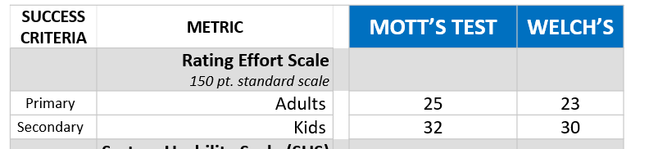
Welch’s and Mott’s pouches require the same amount of effort to tear open.
For Adults and kids, both pouches only require “A Little Effort” to use. No significant difference in effort between Mott’s and Welch’s pouches.
*Product are significantly different at the 95% confidence interval

Slide 18
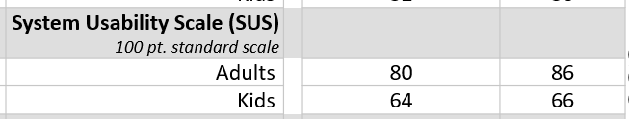
No significant difference between Mott’s and Welch’s in SUS.
*Product are significantly different at the 95% confidence interval
Usability for adults is well above the 68 pt. threshold and is in line with usability of Thermometers, Amazon.com, and Gmail. No significant difference in SUS scores between Mott’s and Welch’s for Adults or Kids.

Slide 19
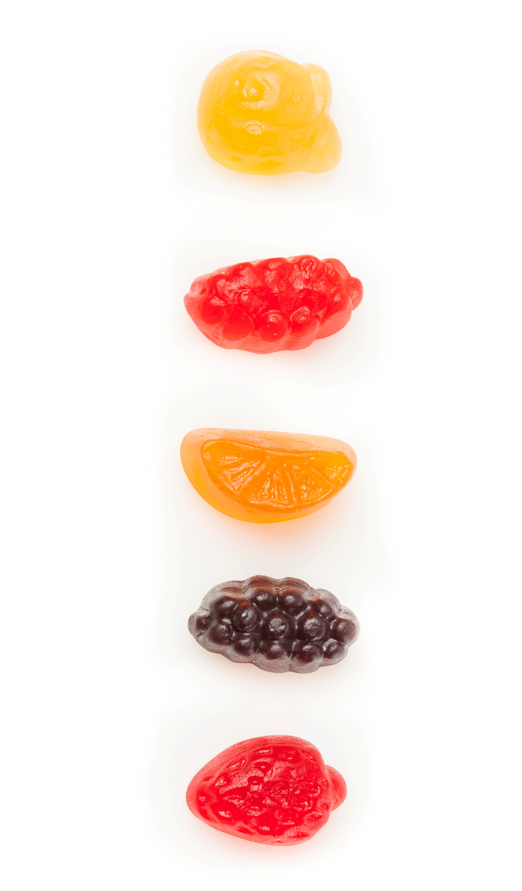
Voice Survey results

Slide 20
Mott’s tear notch performance is almost on par with Welch’s, but was slightly harder to locate
Voice survey Q. Did you succeed to locate the tear notch? Did the tear notch help you in opening the pack? Yes/No. N=198

Slide 21
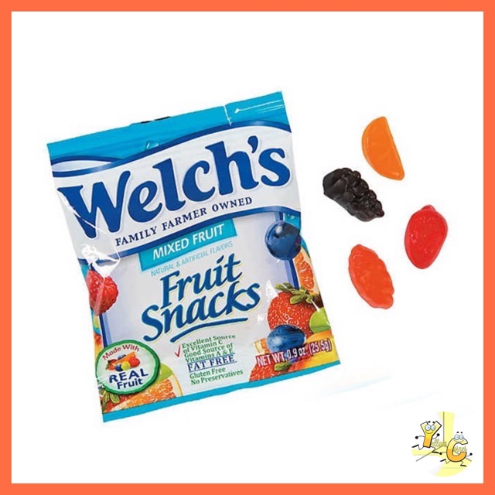
tear notch Made it easy to open the pack, but some struggled to locate it
The Welch’s slit was easier to locate
Mott’s was more user friendly for children
Voice survey Q. Did the tear notch help you in opening the pack? Why or Why not? N=198.

Slide 22
While the majority were satisfied with the current opening, some suggested adding clear instruction
Voice survey Q. Do you have any suggestions to help us make it easier to open the pack? N=198.

Slide 23
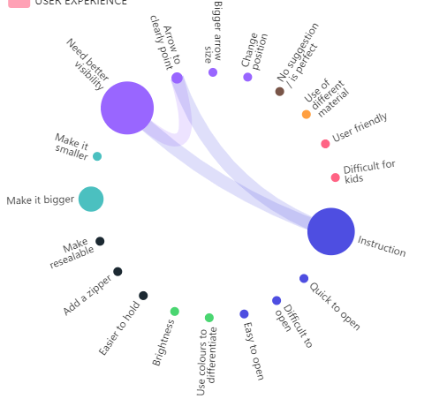

improving visibility of the Mott’s tear notch is recommended
“Maybe have a like an arrow suggesting to open the notch because just initially seeing the pouch I don't see the tear notch.”
“Put a drawing or icon where the notch is.”
“Maybe make a notch a little easier to see if I kind of like a picture, like an arrow pointing to where you should change it from.”
Voice survey Q. Do you have any suggestions to help us make it easier to open the pack? N=99, Mott’s

Slide 24
Group 2 – Mott’s Control vs. Mott’s Test
Is Mott’s Test with the tear notch an easier to open experience than Mott’s Control without a tear notch? Can we claim “now easy to open”?

Slide 25
Mott’s Test is a significantly easier opening experience than Control.
*scores in this table reflect comparison between tear from edge method, not pinch and pull method.
METRIC |  | MOTT’S TEST | MOTT’S CONTROL
Rating Effort Scale 150 pt. standard scale (lower = less effort)
Adults |  | 27* | 79
System Usability Scale (SUS) 100 pt. standard scale (higher = more usable)
Adults |  | 77* | 39
Kids |  | 45 | 42
Preference (Mott’s, Welch’s, or Neither)
Adults |  | 71% | 14%
Child Opening % kids could open on their own
Kids |  | 76% | 27%
Overall Package Liking 9pt. Hedonic
Adults |  | 7.2* | 6.4
Superiority –Mott’s pouch is sig. higher than Welch’s pouch
Parity – Mott’s pouch is at parity with Welch’s pouch
Inferiority – Mott’s pouch is sig. lower than Welch’s pouch
SUS scores are adult focused for benchmarking. Kid SUS scores should only be looked at directionally and compared between samples, not benchmark values.
*Significant difference at 95% CI.

Slide 26
Group 2 Diagnostics

Slide 27
Mott’s Test pouch is significantly more preferred over Mott’s Control pouch.
11%
Neither, Both Easy
“The second batch [Mott’s Control] of pouches are way more difficult to open than the first batch. It comes down to how much strength I had to exert to open a simple pouch of fruit snacks, a product consumed regularly by children. I'm sure some older kids would be able to open even the second batch on their own but the amount of kids able to do so drops drastically.”
5%
Neither Both Difficult
14%
Mott’s Control
71%
Mott’s Test
“It [Mott’s Control] was more difficult to open then I was prepared for. Also the idea of my daughter getting it open when In school. The pouch was slightly difficult to pinch in order to open I imagine kids struggling to open and it ripping and the snacks going everywhere.”

Slide 28
Mott’s Test is liked significantly more than Mott’s Control pouch.
Overall Package Liking
Mott’s Control
6.4
Mott’s Test
7.2*
1
2
3
4
5
6
7
8
9
Liking (9-pt. scale)
*Product are significantly different at the 95% confidence interval

Slide 29
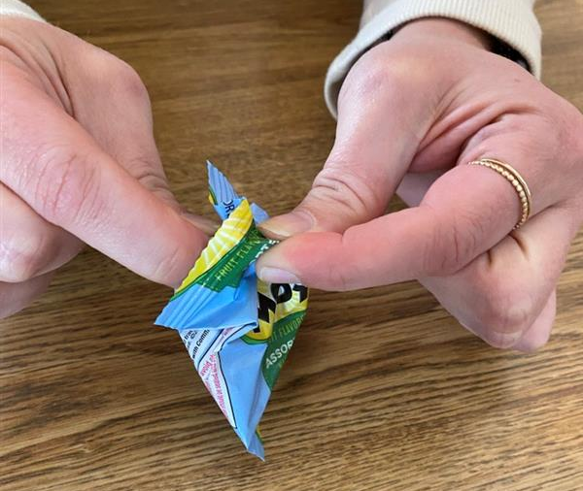
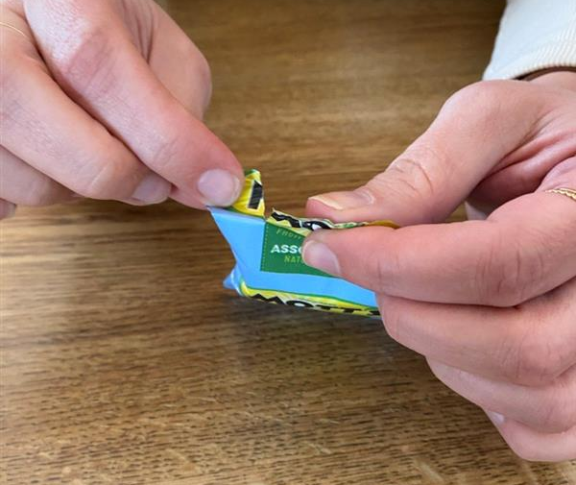
Mott’s Control requires much more effort to tear open than Mott’s Test.
Pinch Pull Open
Tear Open
Sample | Mott’s Control | Mott’s Test
Pinch Pull Open RES | 37 | 27*
Tear Notch Open RES | 79 | 27*
*Product are significantly different at the 95% confidence interval
The pinch pull open of the pouches work similarly well for Control and Test (expected). The big difference is in the tear method usability. Mott’s Control requires a considerable effort to open using the tearing method compared to the Test pouch which requires only a little effort. The tear notch will create a significantly easier opening experience for the 2/3rds of consumers who like to open via the tear from edge method.

Slide 30
Mott’s Test is significantly easier to use than Mott’s Control for adults. No difference in usage for kids.
Pinch Pull Open
Tear Open
Sample | Mott’s Control | Mott’s Test
Pinch Pull SUS | 74 | 79*
Tear Notch SUS | 39 | 77*
Kid SUS | 42 | 45
Similarly, the pinch pull open method has similar usability in Control and Test (expected). The difference again is that the Mott’s Control sample does not perform well in tearing open (which we know 2/3rds of consumers use to open pouches) and is significantly less user friendly than Mott’s Test pouch.
*Product are significantly different at the 95% confidence interval

Slide 31
Summary of Key Learning
Mott’s Test vs. Welch’s
Mott’s Test vs. Control
Mott’s is at parity to Welch’s in tear notch usability.
Opportunities for Mott’s improvement:
Place tear notch in top right corner.
Make tear notch more visible.
Direct consumer attention to tear notch.
Mott’s Test tear notch creates a significantly easier opening experience.
Move forward with a claim of easier to open.
Gogurt Example:
“Now easier to open” – 6 month claim
“Easy open” – evergreen claim
Consider using “tear notch”, or similar language, to tell consumers the tear notch is what makes it easier to open.

Slide 32
Appendix

Slide 33
Demographics and Usage

Slide 34
Demographics & Usage
Child Age | Group 1 % | Group 2%
2 | 8% | 11%
3 | 8% | 5%
4 | 13% | 13%
5 | 16% | 12%
6 | 11% | 13%
7 | 9% | 20%
8 | 13% | 13%
9 | 8% | 3%
10 | 5% | 5%
11 | 4% | 1%
12+ | 4% | 6%
Consumption Frequency | Group 1% | Group 2%
At least once a day | 34% | 44%
2-3 times a week | 55% | 41%
Once a week | 8% | 10%
Once every other week | 3% | 4%

